Slide 1



MATHEMATICS
CLASS-VII
SHARIQUE MINHAZ
PRT MATHEMATICS

Slide 2
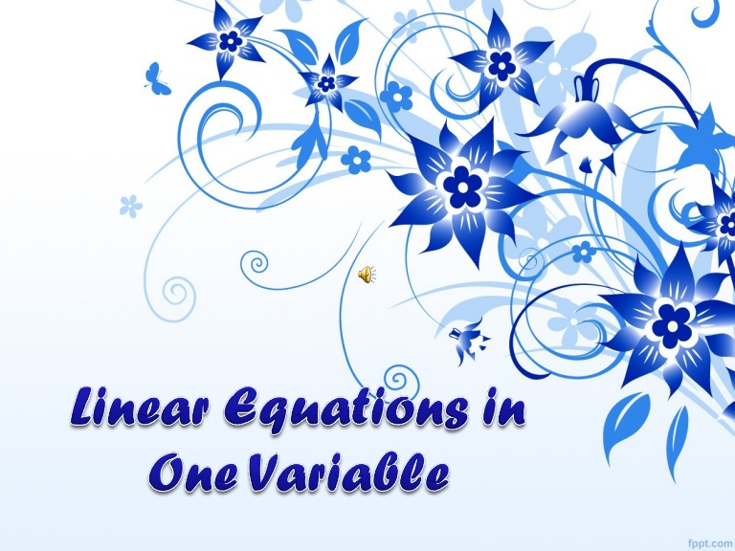

Slide 3

LEARNING OBJECTIVES
Identify key words and phrases, translate sentences to mathematical equations, and develop strategies to
solve problems.
Solve word problems involving relationships between numbers.
Solve geometric problems involving perimeter.
Solve percentage and money problems including simple interest.
Set up and solve uniform motion problems.

Slide 4

Game……
THINK OF a number.
Multiply it by 2.
Add 10 now.
Divide the number by 2
Now Subtract 5 from the number.
Now you will get the number which you took in starting.
Notes:
First of all, teacher will organize a game for all the students, in which he/she will tell them to suppose a number…

Slide 5
WHAT DO YOU UNDERSTAND BY THIS ?
It’s
a
Mathematical
Magic
Ok, So Today we will learn about some more mathematical tricks….

Slide 6
What do you observe in both the pictures ?
A= 5
B= 8
X= 12
A= #
B= ##
X= *#
I
II
There are two circles, In first circle the value of A,B and X are specified but in second circle it is unknown.

Slide 7

A letter or symbol that stands for an unknown number is called Variable.
A letter or symbol that stands
for a known number is
called Constant.
Notes:
Teacher will explain both the term (i) Constant (ii) Variable

Slide 8
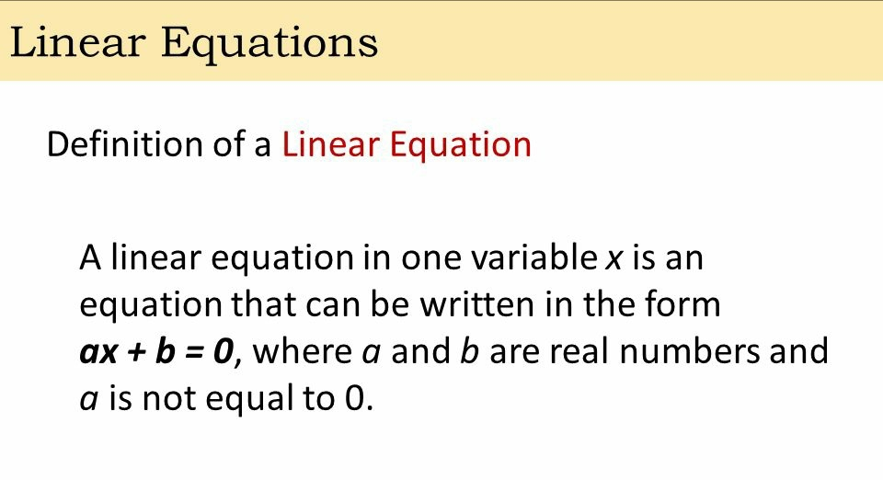

Slide 9

A LINER EQUATION IS ALSO CALLED A FIRST DEGREE
EQUATION AS THE
HIGHEST POWER OF VARIABLE IS 1.
EXAMPLE OF LINER EQUATIONS :
x + 4 = - 2
2x + 5 = 10
5 – 3x = 8

Slide 10

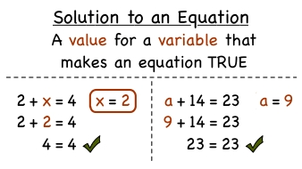

Slide 11

THERE ARE TWO WAYS TO SOLVE A LINEAR
EQUATION IN ONE VARIABLE
INVERSE OPERATION METHOD
TRANSPOSITION METHOD
LINEAR EQUATION FORMATION ACTIVITY VIDEO

Slide 12

INVERSE OPERATION METHOD
INVERSE OPERATION METHOD VIDEO
The linear equations in one variable can be solved
mathematically in a systematic method by the inverse operations.
In this method, both sides of the linear equation are
balanced by the basic mathematical operations
inversely for making variable to appear at one side
and its equivalent quantity to appear at the other Side
of the equation.
The inverse operations method is always recommendable and
better than the other method.

Slide 13
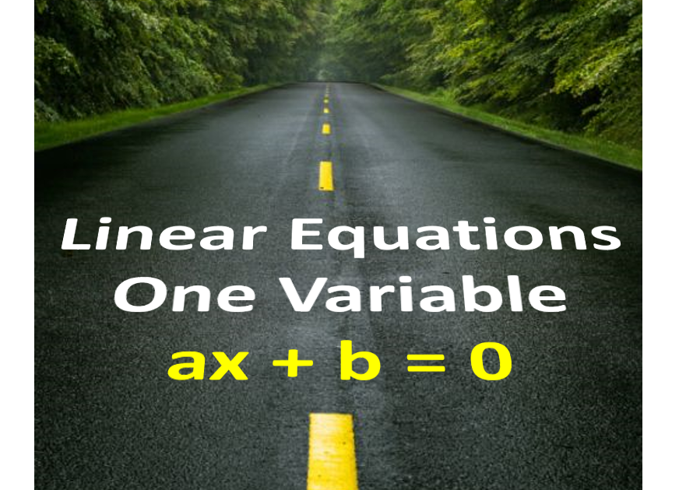
Addition form
If a variable is connected to a number by addition at one side of the equation, then use opposite operation subtraction in both sides of the linear equation for eliminating the number from one side of the equation completely.
x+9=14
In the left-hand side expression, the number 9 is added to variable x. It should be eliminated from this expression to find the value of x. So, let us subtract 9 from the left-hand side expression . But it makes the right-hand side expression imbalanced. Therefore, subtract both sides of the equation by 9 for making the equation systematic and balanced.
⟹ x+9−9=14−9
⟹ x+9−9=5
∴ x=5

Slide 14
Subtraction form
If a variable is connected to a number by subtraction at one side of the equation, then use its inverse operation addition at both sides of the linear equation for eliminating the number completely from one side of the equation.
x−5=11
The number 5 is subtracted from variable x. In order to solve x, it must be eliminated from left-hand side expression and it is possible by adding 5 to the expression but the expression in the right-hand side become imbalanced due to this operation. However, It can be balanced
by adding 5 to both sides of the equation.
⟹ x−5+5=11+5
⟹ x−5+5=16
∴ x=16

Slide 15
Multiplication form
If a variable is connected to a number by multiplication at one side the linear equation, then try its inverse operation division at both left and right-hand sides of the equation for solving the variable.
4x=24
In this example, the number 4 is multiplied to variable x. For finding the value of x, it’s essential to eliminate the number 4 from the expression. It is usually done by the division but it imbalances the right-hand side of the equation. So, divide both sides the equation by the coefficient of the variable.
⟹ 4x/4=24/4
⟹ 4x/4=24/4
∴ x=6

Slide 16
Division form
If a variable is connected to a number by division in one side of the linear equation, then apply its inverse operation multiplication in both the sides of the mathematical equation for evaluating the variable.
x/8=2
The number 8 divides the variable x in this example. To solve for the value of x, it is necessary to eliminate the number 8 from the expression. It can be done by the multiplication and it imbalances the right-hand side expression. Therefore, it is essential to multiply 8 to both sides the equation .
⟹ 8 ×x/8=8 ×2
⟹ 8x/8=16
⟹ 8x/8=16
∴ x=16

Slide 17
TRANSPOSITION METHOD
TRANSPOSE METHOD PDF
By transposing a term from one side to another side, we mean changing its sign and carrying it to the other side. In transposition, the plus sign of the term changes into minus sign on the other side and vice –versa. The transposition method involves the following steps:
Obtain the linear equation.
TRANSPOSE METHOD VIDEO

Slide 18
Identify the variable and constants.
Simplify the L.H.S. and R.H.S. to their simplest forms by removing bracket.
Transpose all terms containing variable on L.H.S. and constant term on R.H.S.
Note that the sign of the terms will change in
shifting them from L.H.S. to R.H.S. and vice-versa.
Simplify L.H.S and R.H.S. in the simplest form so
that each side contains just one term.
Solve the equation obtained in Step V by
dividing both sides by the coefficient of the variable on L.H.S.

Slide 19
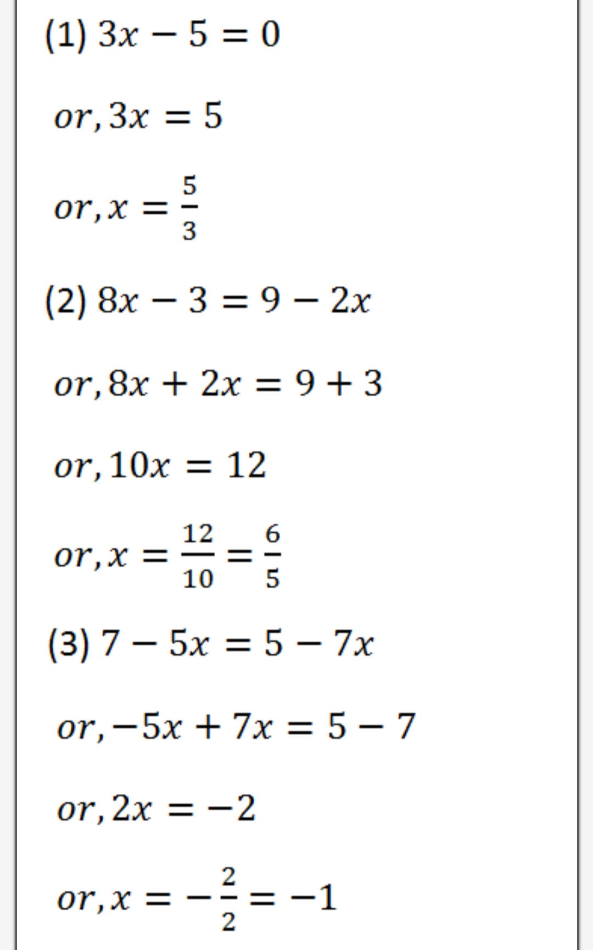
Example of
TRANSPOSITION METHOD

Slide 20
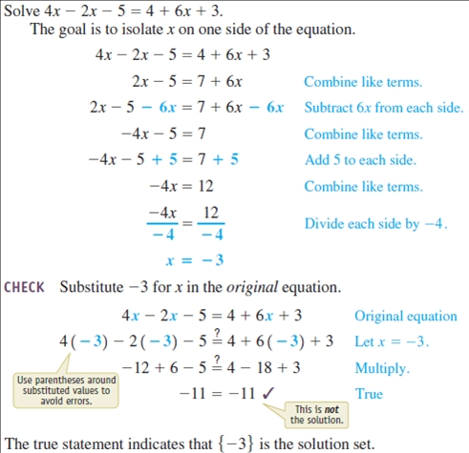
Checking of linear equation

Slide 21
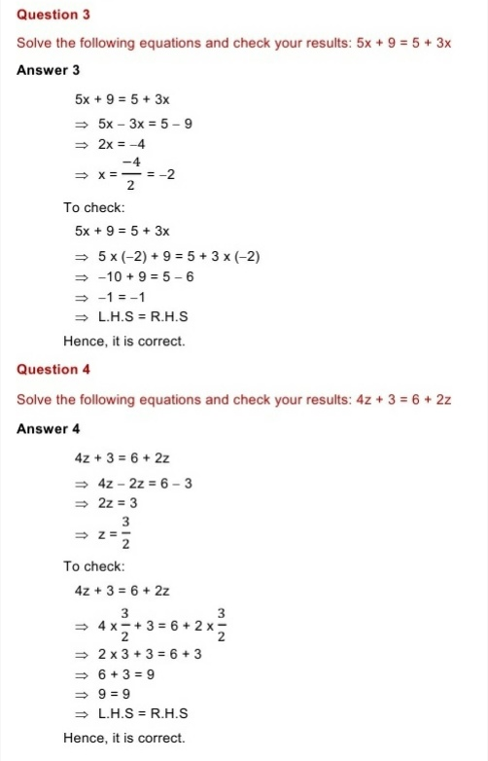
Checking of linear equation

Slide 22
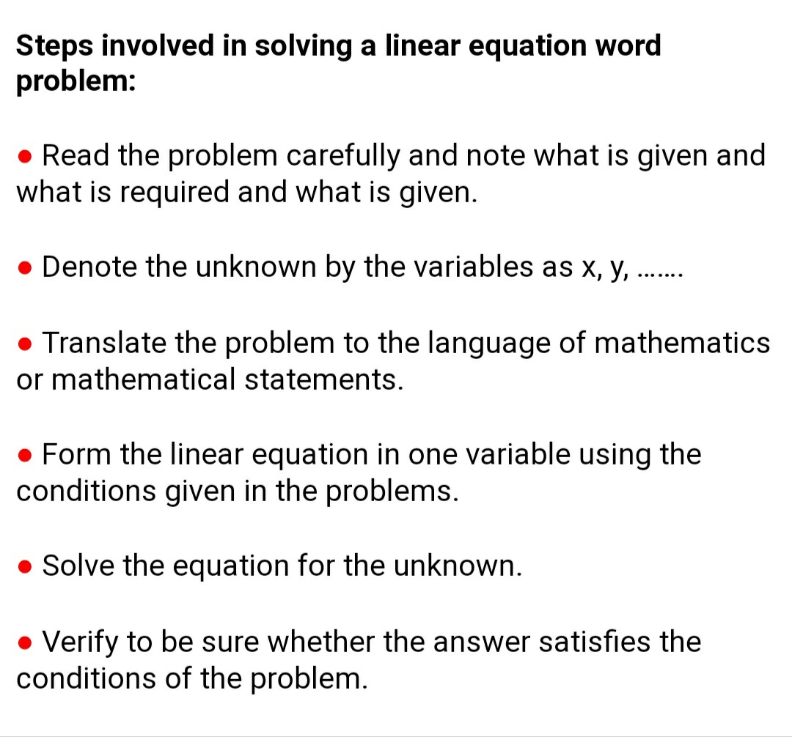
Word problems

Slide 23
  Example 1: Translate: Four less than twice some
  number is 16.
  Solution: First, choose a variable for the unknown
  number and identify the key words and phrases.
  Let x represent the unknown indicated by
  “some number.”
  2x-4=16
  Remember that subtraction is not commutative.
  For this reason, take care when setting up
  differences.
  In this example, 4−2x=16
  is an incorrect translation.
  Answer: 2x−4=16

Slide 24

  Example 2: The difference between two integers is 2. The larger
  integer is 6 less than twice the smaller. Find the integers.
  Solution: Use the relationship between the two integers in the second
  sentence, “The larger integer is 6 less than twice the smaller,”
  to identify the unknowns in terms of one variable.
  Let x represent the smaller integer
  Let 2x-6 represent the larger integer
  Since the difference is positive, subtract the smaller integer from
  the larger. (2x-6)-x=2
  Solve.
  2x-6-x=2
  X-6=2
  X-6+6=2+6
  X=8
  Use 2x − 6 to find the larger integer.
  2x-6=2(8)-6=16-6=10
  Answer: The two integers are 8 and 10. These integers clearly solve
  the problem.

Slide 25
Example-3The difference between the two numbers is 48. The ratio of the two numbers is 7:3. What are the two numbers?
Solution:
Let the common ratio be x.
Their difference = 48
According to the question,
7x - 3x = 48
⇒ 4x = 48
⇒ x = 48/4
⇒ x = 12
Therefore, 7x = 7 × 12 = 84
3x = 3 × 12 = 36

Slide 26
Simplify the process of solving real-world problems by creating mathematical models that describe the relationship among unknowns
se algebra to solve the resulting equations.
Guessing and checking for solutions is a poor practice. This
technique might sometimes produce correct answers, but is unreliable,
especially when problems become more complex.
Read the problem several times and search for the key words
and phrases. Identify the unknowns and assign variables or expressions to the unknown quantities. Look for relationships that allow you to use only
one variable. Set up a mathematical model for the situation and use
algebra to solve the equation. Check to see if the solution makes
sense and present the solution in sentence form.
Do not avoid word problems: solving them can be fun and rewarding. With lots of practice you will find that they really are not so bad after all.
Modelling and solving applications is one of the major reasons to study
algebra.
Do not feel discouraged when the first attempt to solve a word
problem does not work. This is part of the process. Try something different and learn from incorrect attempts.
Advice for students

Slide 27
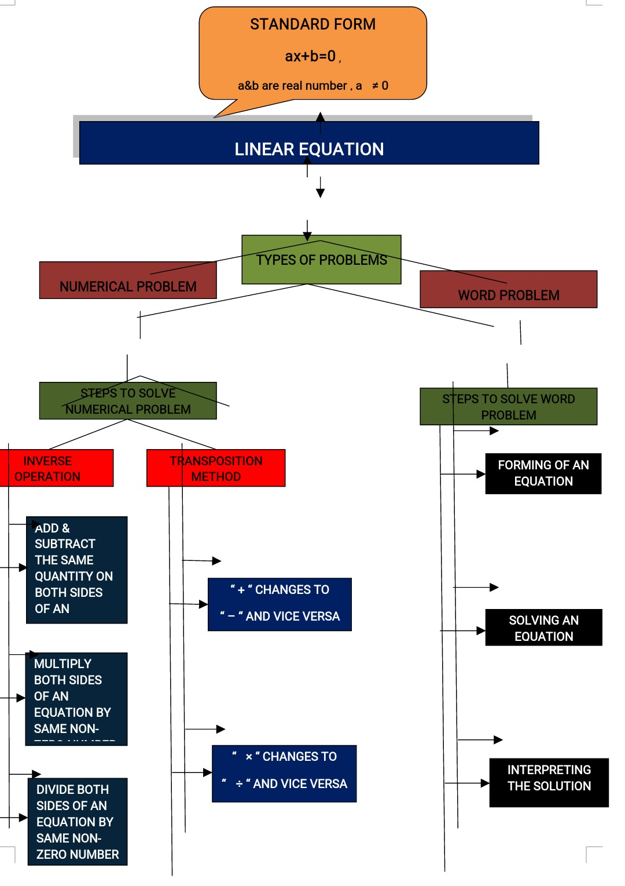
CONCEPT MAP

Slide 28
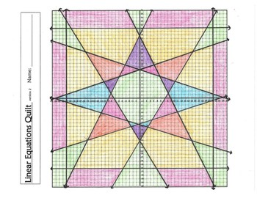

A graphical structure of linear equation
showing a beautiful pattern
Notes:
A graphical structure of linear equation showing a beautiful pattern

Slide 29
HOME ASSIGNMENT
Algebra language Bingo
Draw up a 3 X 3 grid and pick 9 of these and fill in your grid
X +3 | 3a - 2
b - 3 | 4x + 6
3b | y-9
2x - 5 | g-5
m + n | 3(x – 2)
X - 4 | 2(a + b)
2k | 3x + 6
3 + 5 + 7 | 4A
2p + 2 | Y + 3
mf | 6y
Notes:
HOME ASSIGNMENT

Slide 30



